Slide 1
Smart Dustbin Project Using Arduino
Revolutionizing Waste Management
Tasin Rashid. CS-2102059
Nazmul Hossain. CS-2203060
Md Adnan Saki. CS-2203056

Slide 2
Introduction

Slide 3
Components
Arduino UNO : The brain of the project
Ultrasonic sensor : For object detection
Servo motor : To control the lid movement
Dustbin : The main container
Led : For monitoring command.
Jumper wires : Make connet path.
Power source : To power the system

Slide 4
Working Principle
The ultrasonic sensor detects an object (like a hand) within a certain range.
It sends a signal to the Arduino.
The Arduino processes the signal and commands the servo motor.
The servo motor opens the lid for a set time before closing it automatically.

Slide 5
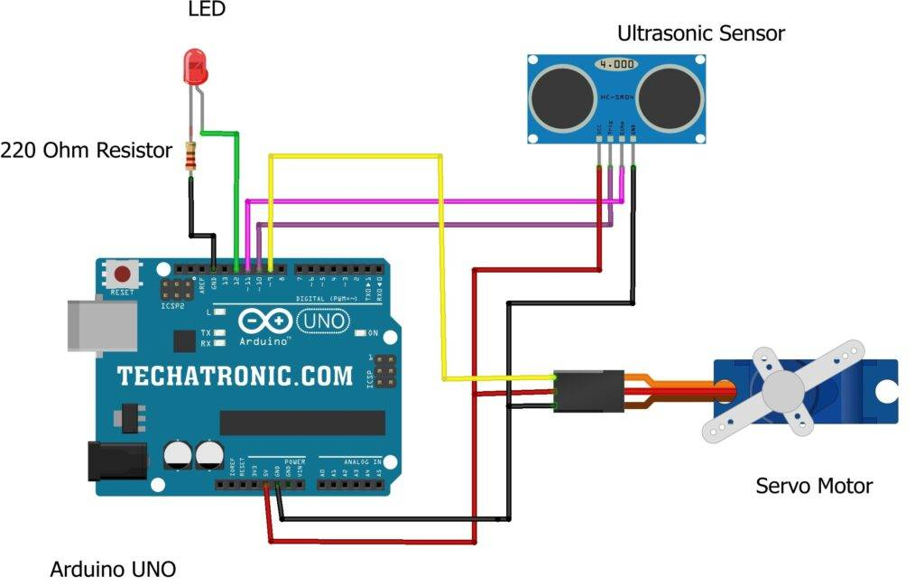
Circuit Diagram

Slide 6
Code
#include <Servo.h>
const int trigPin = 9; // Ultrasonic sensor trig pin
const int echoPin = 10; // Ultrasonic sensor echo pin
const int servoPin = 7; // Servo motor control pin
Servo servo; // Create a servo object
void setup() {
Serial.begin(9600);
pinMode(trigPin, OUTPUT);
pinMode(echoPin, INPUT);
servo.attach(servoPin);
}
void loop() {
long duration, distance;
digitalWrite(trigPin, LOW);
delayMicroseconds(2);
digitalWrite(trigPin, HIGH);
delayMicroseconds(10);
digitalWrite(trigPin, LOW);
duration = pulseIn(echoPin, HIGH);
distance = duration * 0.034 / 2;
if (distance < 20) { // Adjust this threshold according to your setup
openLid();
delay(5000); // Keep the lid open for 5 seconds
closeLid();
}
delay(500); // Adjust the delay as needed to control the sensor reading frequency
}
void openLid() {
servo.write(0); // Adjust the angle to open the lid completely
}
void closeLid() {
servo.write(90); // Adjust the angle to close the lid completely
}

Slide 7
Benefits
Efficient waste disposal
Reduction in manual effort
Environmentally friendly solution

Slide 8
Applications
Smart cities
Public places
Homes and offices

Slide 9
Thats all

